Slide 1
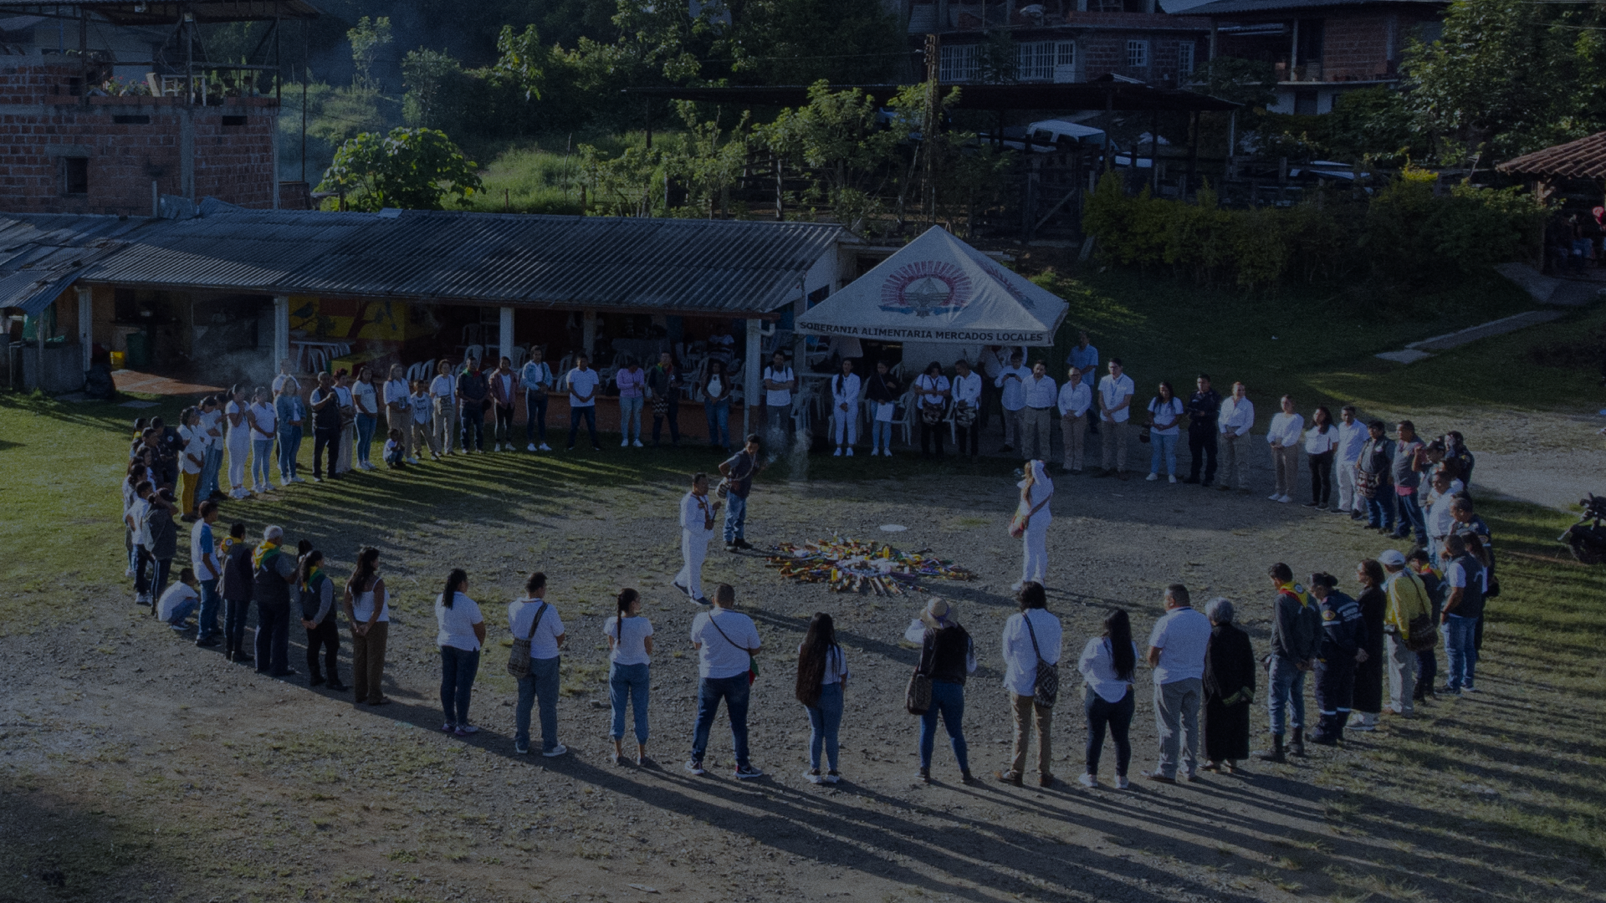

Medidas de Contribución a la Reparación (Measures to contribute to reparation)
SDSJ
Chamber for the Definition of Legal Situations - SDSJ

Slide 2


“Camino de la Memoria” (Path to Memory)
The MCR includes a public commemorative event honoring victims of extrajudicial executions in the Casanare department. Additionally, it involves the installation of 19 memorial plaques—one in each municipality—
CASANARE HONORS THE MEMORY AND DOES NOT FORGET
Between the years 2002 and 2008, in the department of Casanare, troops of the 16th Brigade of Colombian National Army, state agents not belonging to the security forces, and civilian third parties planned, murdered, and disappeared innocent and defenseless people in order to falsely present them as combat kills.
The victims of these acts were, in fact, peasants, workers, human beings with hopes and dreams people who were valuable to their families, their communities, and our society.
Memory is the refuge of dignity; truth is the legacy of the victims.

Slide 3
“Camino de la Memoria” (Path to Memory)
acknowledging that the victims were wrongfully killed by the Colombian Army and falsely presented as combat casualties. The event, to be held in Yopal, aims to secure the commitment of local governments to install the plaques in coordination with victims' families. During the ceremony, five individuals involved in the crimes are expected to publicly acknowledge responsibility.
Restorative Line | Territory | Start Date | Participants
Memory and Symbolic Reparation | 19 municipalities in Casanare | January 1, 2025 | - 20 Non-Determining Participants - 75 Accredited Victims

Slide 4
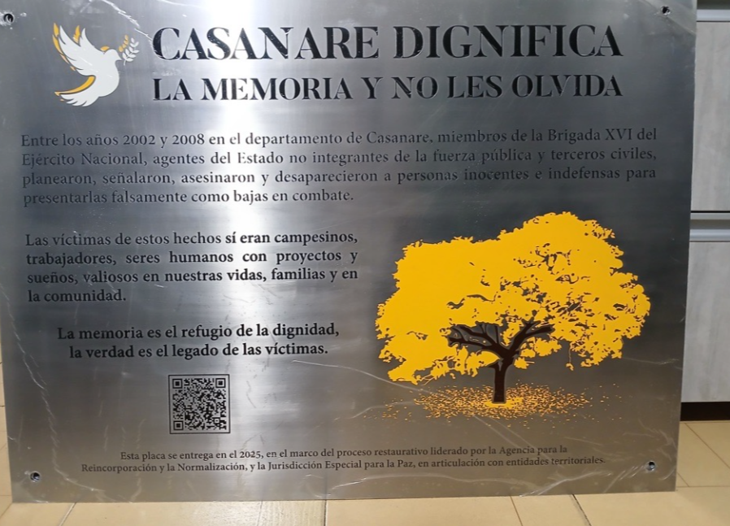
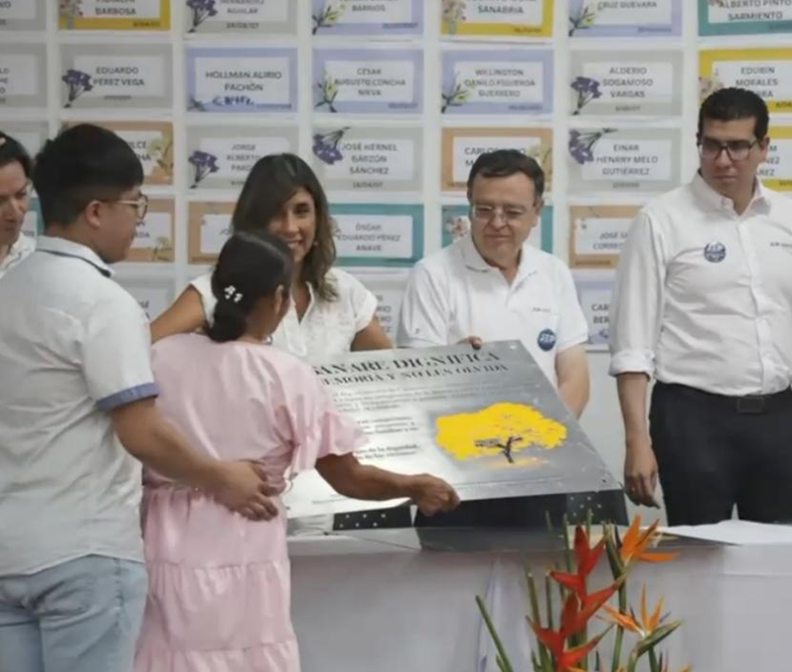
Strengths, Opportunities, and Lessons Learned
Strengths:
ARN workshops aligned expectations and strengthened restorative understanding.
IOM activities involved children and adolescents, reinforcing family engagement.
Pre-project hearings built trust through early truth clarification.
Opportunities:
Identification and return of José Albeiro Vargas’s body strengthened ties with indirect victims and positively impacted the MCR.
Area for Improvement:
Six-month timeline was too short; more preparation time is needed.
Participant limit should be expanded to include more non-determining actors.

Slide 5
“Recorrido por el Mojao” (Tour through El Mojao)
The MCR consisted of a hearing that included a harmonisation ritual led by the Sagas' and Mamos' spiritual authorities. Afterwards, a symbolic journey was carried out with some of the participants: from the site where the victims were taken, through the path where they were executed, to the place where their bodies were found after the combat operation was falsified. This was a restorative and symbolic act of public acknowledgement and forgiveness, conducted in response to the demands of the victims and indigenous authorities.
Restorative Line | Territory | Start Date | Participants
Memory and Symbolic Reparation. Differential damages and macro-victimization. | Valledupar | July 31, 2024 | - 11 Non-Determining Participants - 4 Accredited Victims

Slide 6
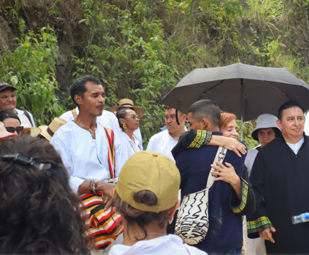
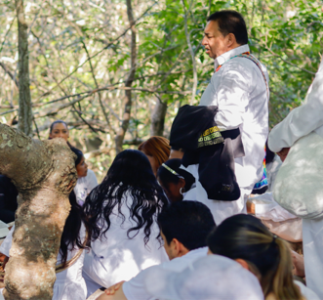
Strengths, Opportunities, and Lessons Learned
Strengths:
Recognized the territory as a victim and addressed harm to indirect victims under Macro Case 03.
Opportunities:
Magistrate José Hormiga’s Indigenous identity enabled respectful, culturally appropriate dialogue with Wiwa and Kankuamo authorities.

Slide 7
“Renacer por respeto a la vida” (To Be Reborn Out of Respect for life)
A symbolic and restorative memorial event was held to honour the victims of extrajudicial killings in the Gaula Tolima case, and to promote recognition, truth and reconciliation. The event comprised four key elements: A memorial mass at the Metropolitan Cathedral of Ibagué; a symbolic walk to the Panóptico; a public restorative act in which eleven participants acknowledged responsibility and returned military medals; and a guided visit to the 'Renacer por el Respeto a la Vida' art exhibition.
Restorative Line | Territory | Start Date | Participants
Memory and Symbolic Reparation. | Ibagué. Bogotá D.C | November 15, 2024 | - 29 Non-Determining Participants - 63 Accredited Victims

Slide 8
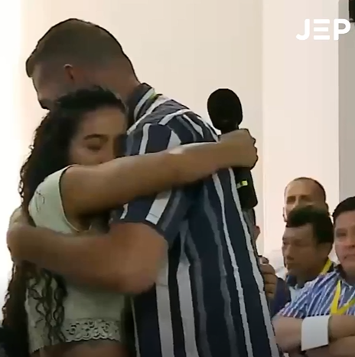
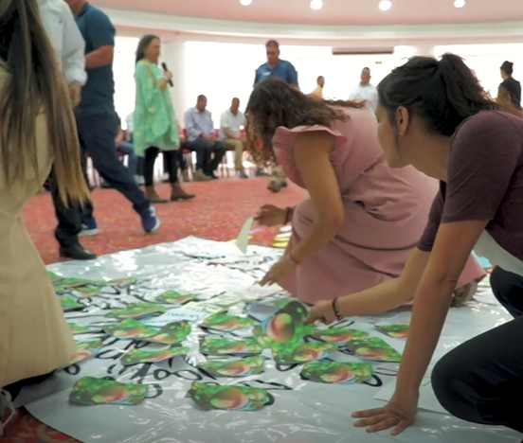
Strengths, Opportunities, and Lessons Learned
Strengths:
The victims felt that their right to the truth had been honoured through the early dialogue and the detailed and sincere testimonies of the participants.
The itinerant exhibition promotes remembrance and dignity across territories.
The engagement of local authorities and other stakeholders increased the event's reach.
Opportunities:
High level of commitment and generosity from both victims and participants in jointly designing the measure.
Voluntary support from the University of Tolima strengthened implementation.
Area for Improvement:
The short timeframe limited the measure’s potential impact and reach.
Broader inclusion of victims affected by Gaula Tolima was hampered by the tight implementation schedule.

Slide 9
“Caminos de Memoria y Reconciliación” (Paths of Memory and Reconciliation)
The project aims to provide reparations for indirect victims and communities affected by events within Macro Case 03, particularly the Santa Ana community in Antioquia. The project includes four key actions: i) Restoring 12 km of road to reconnect Santa Ana with the Bogotá–Medellín highway and promote economic and tourism development; ii) Creating murals to honour direct victims, with guidance from memory artist Joselo, involving victims and defendants; iii) Building the 'Casa de la Memoria de Santa Ana’ iv) Supporting the recovery and dignified return of persons disappeared by Battalion No. 4 (BAJES).
Restorative Line | Territory | Start Date | Participants
Rural and Urban Infrastructure, Memory and Symbolic Reparation, Search for the Disappeared | Granada, San Luis (Antioquia) | Undefined | - 80 Non-Determining Participants - 40 Accredited Victims

Slide 10
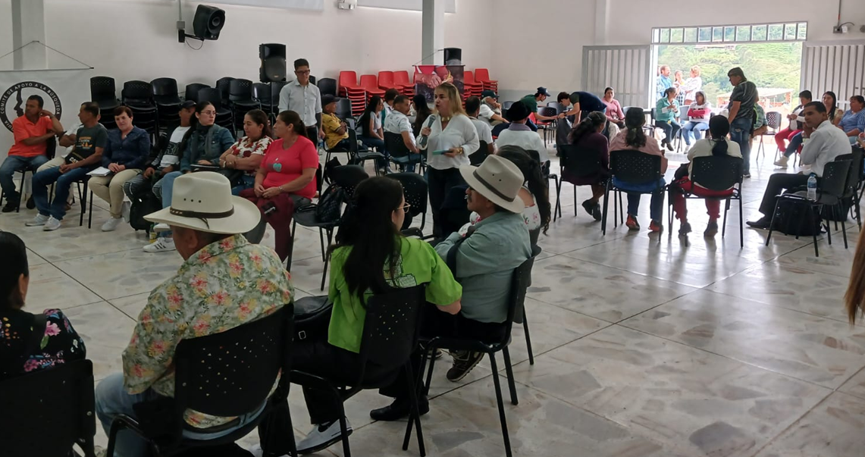
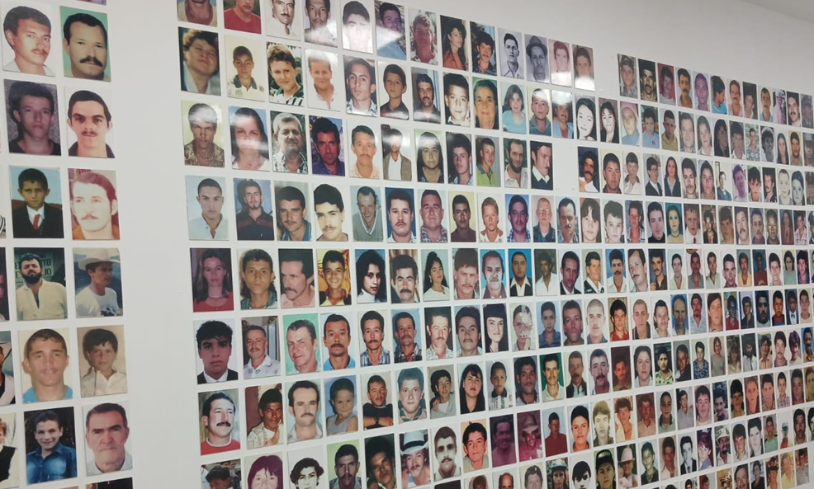
Strengths, Opportunities, and Lessons Learned
Strengths:
The memorial component involves both participants and victims in mural creation, fostering social healing, dignity for victims.
The infrastructure component aims to improve quality of life in Santa Ana by enhancing road connectivity and promoting economic growth and tourism.
Opportunities:
Artist Joselo joined the project voluntarily, bringing strong local legitimacy, collective work experience, and a respected background in memory initiatives.
Victims' organizational capacity allows the project to build on existing collective processes.
Potential partnerships with the Antioquia business sector through corporate social responsibility programs.
Area for Improvement:
Fully implementing all components—especially infrastructure—requires significant financial resources.

Slide 11
“Audiencia de aporte de verdad y seguimiento al régimen de condicionalidad” (april, 2025) (Hearing for Truth-Telling and Monitoring of the Conditionality Regime – April, 2025)
During the hearing, four symbolic acts were carried out as part of the reparation process for participating victims. One family member asked three participants—those directly involved in the murders of her loved ones—to read a letter she had written describing who her relatives were. She also requested the symbolic delivery of a wooden horse, representing her brother’s love for the countryside and horses, bearing the names of the three victims. In another gesture, relatives of two other victims symbolically received a guitar and a hat—objects closely associated with their loved ones. Lastly, the victims’ families handed over clothing worn by the victims on the day of the events, which they had preserved for over 20 years since receiving them from the Forensic Medicine Institute.
Restorative Line | Territory | Start Date | Participants
Memory and Symbolic Reparation. | Neiva | April 10, 2025 | - 9 Non-Determining Participants - 3 Accredited Victims

Slide 12
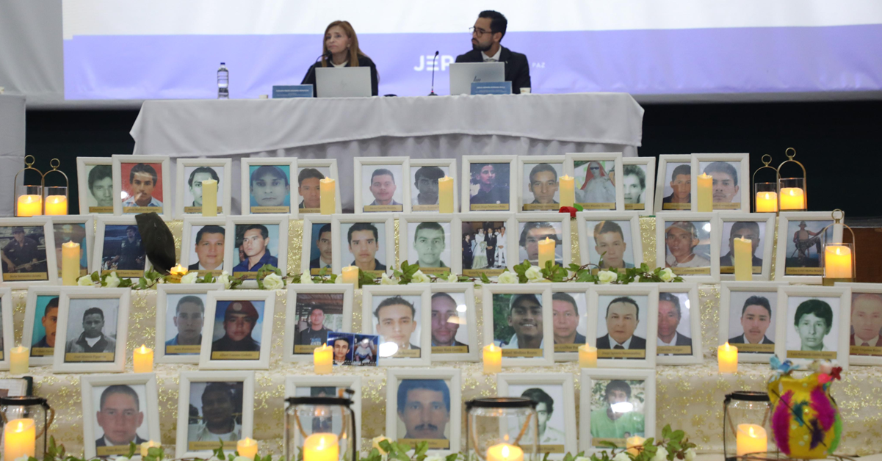
Strengths, Opportunities, and Lessons Learned
Strengths:
The content of the measures was adapted to the victims’ requests, responding to ideas expressed in earlier hearings and reflecting a truly dialogical process.
The approach provided personalized attention to the victims’ histories, needs, and emotional impact, enhancing the reparative effect by acknowledging deeply personal losses within each family.
Area for Improvement:
Given the high number of cases and participants handled by the SDSJ, individualized attention for each victim or family group may exceed the jurisdiction’s time and resource capacity.
Financial limitations are significant; in many cases, symbolic materials for hearings must be secured by JEP staff themselves.

Slide 13
“Audiencia Territorial de Medidas de Satisfacción San Calixto” (Territorial Hearing on Measures of Satisfaction – San Calixto)
During a hearing of the Catatumbo sub-chamber, a family group proposed a reparation measure, emphasizing the importance of truth-telling and acknowledgement of responsibility in the territory and communities where the violations occurred. Consequently, SDJS organized a hearing in which other family groups received direct recognition from the defendants and meaningful reparations. The hearing included symbolic acts, such as a silent march, a photo exhibition, and an opportunity for indirect victims to tell the stories of their deceased relatives.
Restorative Line | Territory | Start Date | Participants
Memory and Symbolic Reparation. | San Calixto | September 20, 2024 | - 26 Non-Determining Participants - 13 Accredited Victims

Slide 14
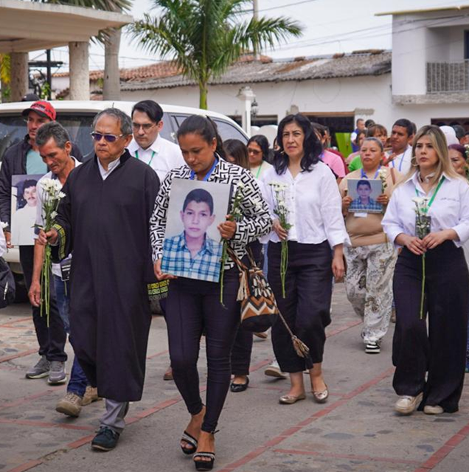
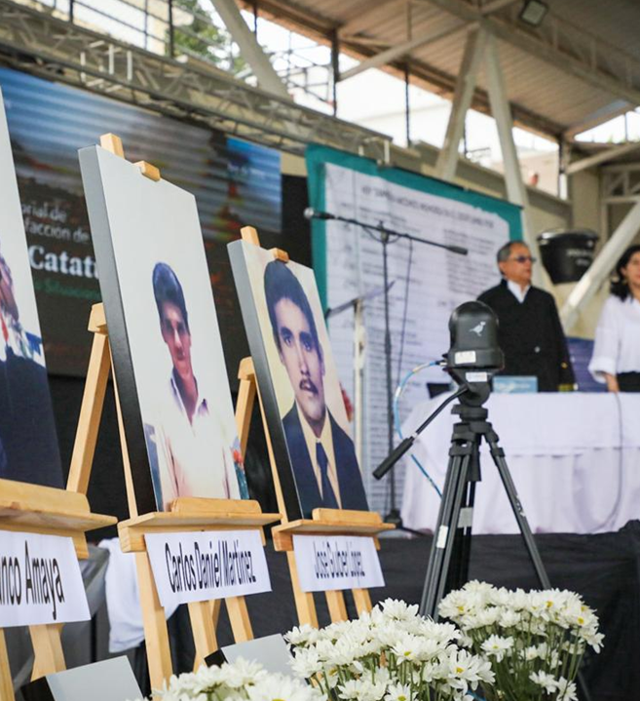
Strengths, Opportunities, and Lessons Learned
Strengths:
Strong connection between JEP and the affected territory
Victims’ active participation in shaping reparation measures
Emphasis on collective benefit, rather than individual redress
Media coverage
Focus on truth and acknowledgement within the community where the harm occurred.
Area for Improvement:
Insufficient clarity regarding institutional roles for territorial preparation and coordination
Limited contextual briefing for advance teams unfamiliar with the region
There is a need to strengthen judicial leadership in overseeing field-based restorative actions

Slide 15
